Slide 1

DEPARTMENT OF COMPUTER SCIENCE AND ENGINEERING
SKILL ENHANCEMENT PROJECT
TASK MANAGEMENT
PROJECT STUDENT
Hejasvini M, 43110288

Slide 2
AGENDA
Abstract
Existing system
Proposed system
Advantages
Disadvantages
Hardware requirements
Software requirements
Modules
Module description
Sample output(screenshot)
Conclusion

Slide 3
ABSTRACT
Task Manager is a software application designed to manage, monitor, and organize system or user tasks effectively.
It helps users view running processes, allocate resources, and prioritize workloads efficiently.
The aim is to improve productivity, optimize performance, and provide an organized workflow for personal or professional use.
The system supports adding, updating, deleting, and tracking tasks in real time

Slide 4
EXISTING SYSTEM
In existing systems, tasks are usually tracked manually or using basic lists/spreadsheets.
Lack of automation leads to missed deadlines and incomplete task visibility.
Limited collaboration among team members.
Users face difficulty in tracking progress or resource utilization.
No integrated notification or reminder system in traditional methods.

Slide 5
PROPOSED SYSTEM
A digital Task Manager that automates and simplifies task tracking and management.
Supports multiple users and categorizes tasks with status, deadlines, and priority levels.
Provides real-time monitoring of running or completed processes (for system-based task managers).
Integrates with other productivity tools like calendars or emails for scheduling activities.
Offers an intuitive interface with search and filter options for quick access.

Slide 6
ADVANTAGES
Improves task organization and personal productivity.
Allows clear prioritization and categorization of tasks.
Makes tracking deadlines and completion status easy.
Offers quick access and editing of tasks in one platform.
Enhances accountability and progress monitoring.

Slide 7
DISADVANTAGES
May become dependent on the application for managing all tasks.
Users face a learning curve when starting to use the tool.
Risk of feature overload and complexity for simple needs.
System downtime or bugs can temporarily block access to task data
Integrating with other tools or platforms can be challenging.

Slide 8
HARDWARE REQUIREMENTS
Processor: Intel i3 or higher.
RAM: Minimum 4 GB.
Storage: 250 MB free disk space.
Display: 1024x768 resolution.
Operating System: Windows / Linux / macOS.
Internet connection (for online synchronization).

Slide 9
SOFTWARE REQUIREMENTS
Operating System: Windows 10 or higher / macOS / Linux (any OS supporting Node.js and Java)
Frontend Requirements:
Node.js (v18 or later) and npm for running the React application
Visual Studio Code (or any preferred code editor)
Backend Requirements:
Java Development Kit (JDK 17 or later)
Spring Boot Framework (version 3.x)
Maven or Gradle for dependency management

Slide 10
SOFTWARE REQUIREMENTS
Database Requirements:
MongoDB Community Server (latest version)
Optionally connected via MongoDB Atlas (cloud database)
Additional Tools:
Postman for testing REST APIs
Web Browser (e.g., Google Chrome) for running and testing the web application

Slide 11
MODULES
User Authentication Module
Task Creation and Management Module
Task Listing & Display
Task Editing/Deleting
Task Prioritization & Categorization
Subtask Management
Search & Filter
Status Tracking (Pending/Completed)

Slide 12
MODULE DESCRIPTION
User Authentication: Handles account login and registration to ensure secure access for each user.
Task Creation: Allows users to add new tasks with details such as title, description, priority, category, date, and time.
Task Editing/Deleting: Enables users to modify or remove tasks when plans change.
Task Listing & Display: Shows all tasks in an organized list with labels for priority, category, deadlines, and actions.

Slide 13
MODULE DESCRIPTION
Task Prioritization & Categorization: Lets users set task priorities (e.g., low, medium) and categorize them for better organization.
Subtask Management: Allows breaking down a task into smaller subtasks for detailed progress tracking.
Search & Filter: Helps users quickly find tasks with search and filter options based on status or keywords.
Status Tracking (Pending/Completed): Tracks and updates the progress of each task, highlighting pending and completed items for clear workflow management.

Slide 14
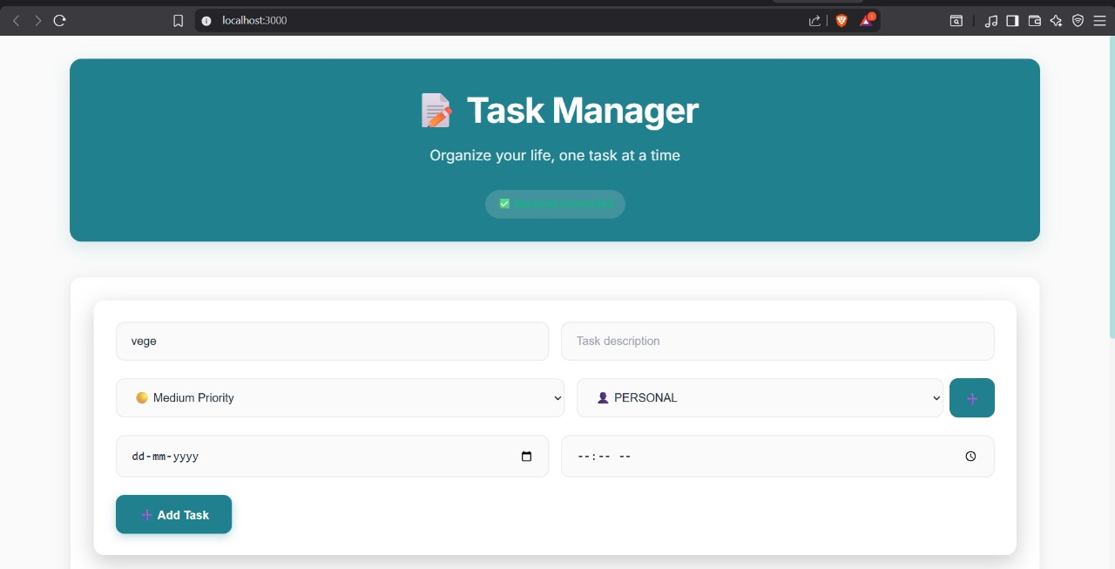
SAMPLE OUTPUT SCREENSHOT

Slide 15
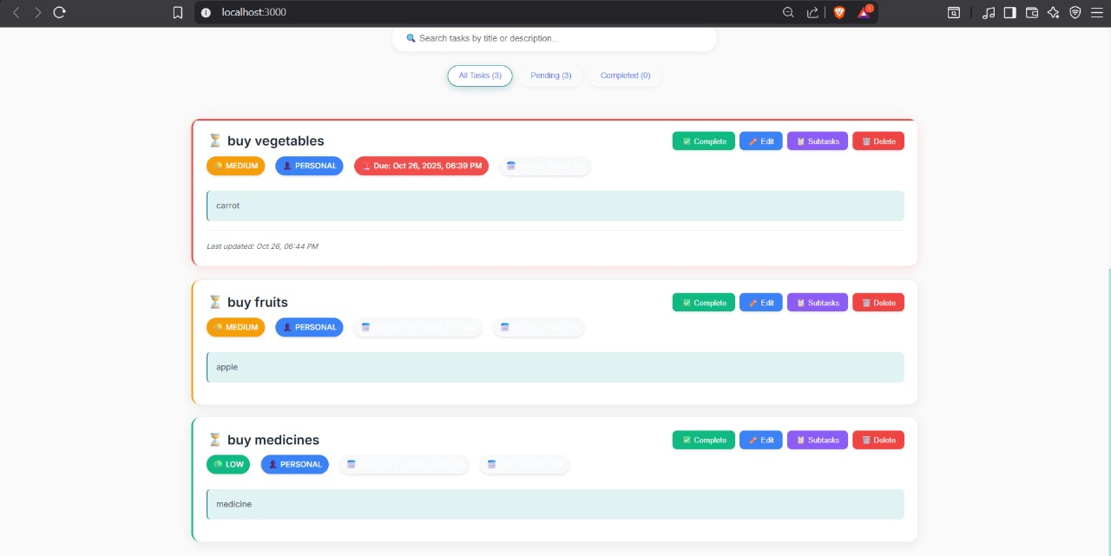
SAMPLE OUTPUT SCREENSHOT

Slide 16
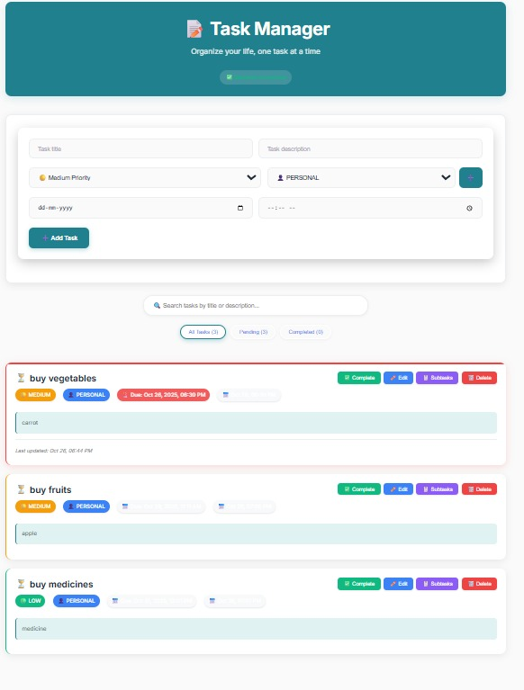
SAMPLE OUTPUT SCREENSHOT

Slide 17
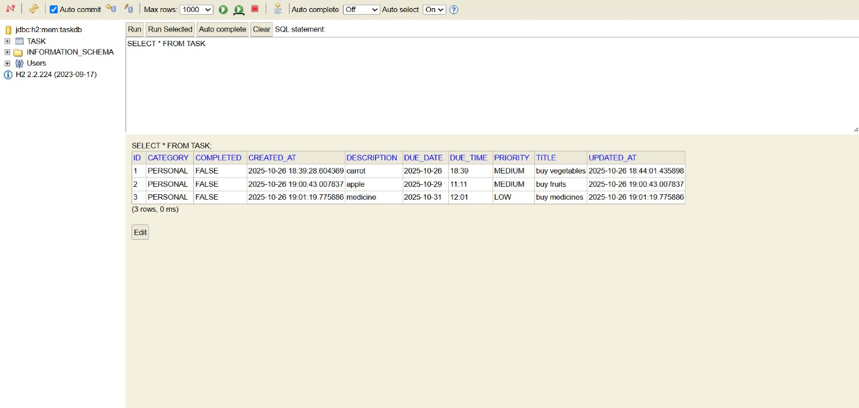
SAMPLE OUTPUT SCREENSHOT

Slide 18
CONCLUSION
The Task Manager system streamlines the process of organizing and tracking tasks effectively.
It enhances productivity, accountability, and user satisfaction by automating task handling.
Future enhancements can include AI-based scheduling, integration with voice commands, and cloud backup.
Overall, it is a robust solution for efficient time and task management.

Slide 19
THANK YOU
Thank you for your time and attention. I sincerely appreciate your guidance and support throughout this project.

